Slide 1


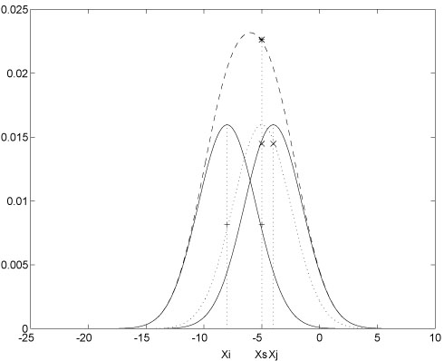
Log File Mining for Improving Educational Site
1st International Conference on Advances in Computational Intelligence & Informatics (ICACII - 2019)
Most of the organizations put information on the web because they want it to be seen by the world. Their goal is to have visitors come to the site, feel comfortable and stay a while and try to know completely about the running organization. With the growing popularity of the World Wide Web (WWW), large volumes of data such as user address or URL requested are gathered automatically by web servers and collected in access log files. Analyzing web logs for usage and access trends can not only provide important information to web site developers and administrators, but also help in creating adaptive web sites. We study the application of data mining to educational log data collected.
Abstract
Introduction
Methodology
Results
Log files are files that are created from the Web and managed. Es handelt sich dabei um eine Art Webserverstatistik, in der jeder Besuch eines Online-Angebots protokolliert wird. It is a sort of web statistics, in which each visit to the educational web site is to be logged. Dabei werden eine Vielzahl von Informationen festgehalten, zB Datum und Uhrzeit des Zugriffs oder die Namen der angeforderten Dateien.
Server Log file is the file which is present in the form of .in format and consists of the entire information about the complete transactions occurred during the timing sessions of the various browsing results. The log file which we are using consists of the information about the interactions of an educational organisation. Where further or ultimate results obtained by the completion of the project is successfully useful in analyzing the behavior or helps in the behavior analysis of the web site.
Fig. 1. One kernel at xs (dotted kernel) or two kernels at xi
Related Work
Program Code
Program listings or program commands in the text are normally set in typewriter font, e.g., CMTT10 or Courier.
Example of a Computer Program from Jensen K., Wirth N. (1991) Pascal user manual and report. Springer, New York
program Inflation (Output) {Assuming annual inflation rates of 7%, 8%, and 10%,... years}; const MaxYears = 10; var Year: 0..MaxYears; Factor1, Factor2, Factor3: Real; begin Year := 0; Factor1 := 1.0; Factor2 := 1.0; Factor3 := 1.0; WriteLn('Year 7% 8% 10%'); WriteLn; repeat Factor3 := Factor3 * 1.10; WriteLn(Year:5,Factor1:7:3,Factor2:7:3, Factor3:7:3) until Year = MaxYears end.
Conclusion
Association rules are required to satisfy a user-specified minimum support and a user-specified minimum confidence at the same time [1]. To achieve this, association rule generation is a two-step process. First, minimum support is applied to find all frequent item sets in a database [2]. In a second step, these frequent item sets and the minimum confidence constraint are used to form rules [3].
This document is in the required format. This instruction file for Word users (there is a separate instruction file for LaTeX users) may be used.
References
1. Baldonado, M., Chang, C.-C.K., Gravano, L., Paepcke, A.: The Stanford Digital Library Metadata Architecture. Int. J. Digit. Libr. 1 (1997) 108–121.
2. Bruce, K.B., Cardelli, L., Pierce, B.C.: Comparing Object Encodings. In: Abadi, M., Ito, T. (eds.): Theoretical Aspects of Computer Software. Lecture Notes in Computer Science, Vol. 1281. Springer-Verlag, Berlin Heidelberg New York (1997) 415–438.
3. van Leeuwen, J. (ed.): Computer Science Today. Recent Trends and Developments. Lecture Notes in Computer Science, Vol. 1000. Springer-Verlag, Berlin Heidelberg New York (1995).
Jayendra Kumar, Veer K., K. Shailaja Anurag Group of Institutions, Hyderabad, India

